Slide 1



Regulatory Affairs Consulting
Let us do what we do best: Your Sanitary Regulation

Slide 2


We are a consultancy that focuses on helping you place your health products and services in the Mexican market through the advice and management of your regulatory compliance.
Thanks to the fact that our team is made up of health professionals and health regulation experts, we are your key ally to develop regulatory strategies according to the particular characteristics of your product and aligned with your commercial strategy.

Slide 3
OUR STORY
2020
Daniela as a freelancer in regulatory affairs while working actively in the industry of medical devices
Entrepreneurship:
SRE registered as a trademark
Independent consultancy services in Regulatory Affairs in México as SRE
Partnership for representing Passarini in Mexico for international regulatory affairs services
SRE as an official company
2019
2017
2016
2013 - 2016
1 License for Fumigators and Pest Control
2 Authorizations for Food supplements
30 Authorizations for medical devices (Registers and importation)
2 Projects in GMPs for Medical Devices
1 Project in developement of new medical devices
10 Authorizations for herbal remedys
8 Authorization for brevages
5 Sanitary Responsibles for establishments
1 Publicity authorization
1 Regulatory strategy for prepared foods
2 Management of digital marketing projects
5 Trainings in Regulatory Affairs for medical devices, International commerce, comercialization of health products in Mexico and Publicity for health products
2 Projects for cosmetics labeling

Slide 4
OUR TEAM 2020
Q.F.B. Daniela González Arroyo
General Direction of Regulatory Projects
Management of Finance & Accounting
Management of Publicity Projects
Sanitary Responsible
Regulatory Project Collaborators
Invoices, taxes and payment support
Publicity and Digital marketing strategies for SRE and for clients. Image. Webpage. Trainings.
Establishment supervision. Trainings. Pharmacovigialnce. Technosurviellance
Regulatory Affairs for health products
Services related to Quality Control, GMPs, Clinical Trials and regulatory advice for developments of new drugs and medical devices
Coordinate projects
General administration
Trainings
C.P. J. Jesús González Villarreal
L.C.C. Oscar Magaña Castillo
Dra. Jessica González Arroyo
Q.A. Claudia Ríos Silva
Development
Authorization
Post-Market
Health expert according the product or Project, active in the industry

Slide 5
OUR TEAM 2020
Daniela
BD: Chemist Pharmaceutical Biologist
7 years experience in Regulatory Affairs
7 years: MD
Jesús
BD: Accountant
40 years of experience as accountant
Oscar
BD: Communication Sciences
8 years of experience in communication and creation of digital content
Jessica
BD: Medicine
Claudia
BD Food Chemist
10 years of experience in the pharmaceutical industry
3 years of experience as general doctor
4 years: HP in general and GMPs
1 year: RA
2 years: QA, QC, GMPs
3 years: Clinical
5 years: RA
Diplomas: FV & TV, Regulatory Affairs, Biochemistry and Molecular Biology, Humanism and Profession
Specialty: Statistics and Quality
Diplomas: Pharmaceutic medicine, clinical Trials, Regulatory Affairs
Curses: Quality, Entrepreneurship, Intellectual property, Tariff Classification, ISO 9001, ISO 13485, Internal Audits, Proteomics, DM classification, Drugs & MD Importation, Checklist for registering MD
Master degree in communication with digital media
Diploma: Humanism and Profession
Curses: Security in Drugs Prescriptions (FV) Advanced Cardiac Life Support, Basic Life Support, Cardiovascular Urgencies, Neonatal Cardiopulmonary Reanimation, Advanced Burn Life Support
Extensive experience in the accounting, financial, and tax area Collaborated in both private and public industry (Mexican government)

Slide 6





OUR CLIENTS: INDUSTRIES REGULATED BY
We have the ability to support from entrepreneurs, new manufacturers, importers and distributors; even large local an foreign companies.
Food and Beverages
Consulting rooms and medical/cosmetic clinics
Cosmetics
Medical Devices
Drug Stores
Fumigators and Pest Control
Drugs
Tattooists, Perforators, Micropigmenters
Herbal Remedies
Food supplements

Slide 7
OUR PROFILE
MISSION
We are committed to support our customers in the introduction of their products to the Mexican market through a specific regulatory diagnosis and solutions attached to current health standards.
VISION
Become the key digital support point for companies, contributing to the improvement of health services and encouraging investment in health products.
VALUES
Honesty
Confidentiality
Quality
Commitment
Empathy
Continuous preparation
Punctuality
Strategy
Full Vision

Slide 8
REGULATORY SOLUTIONS
Translations in different languages
Advertising Strategies and Labeling
Registration and/or product certification
Staff training
Advice on Quality and Product Development
Legal Representation (Hosting)
SANITARY REGULATION
Specific Regulatory Strategies
Technosurveillance
We implement specific strategies for your product so you can start selling it in the market that best suits you, complying with all the applicable regulations.

Slide 9








GLOBAL PRESENCE
Thanks to our incorporation into a “Partnership” system with Passarini, we offer regulatory services, such as registration or legal representation (hosting), in different regions. In this way we support you to have presence in the markets of your interest.
A partner and representative

Slide 10
OUR TEAM 2020
Q.F.B. Daniela González Arroyo
General Direction of Regulatory Projects
Management of Finance & Accounting
Management of Publicity Projects
Sanitary Responsible
Regulatory Project Collaborators
Invoices, taxes and payment support
Publicity and Digital marketing strategies for SRE and for clients. Image. Webpage. Trainings.
Establishment supervision. Trainings. Pharmacovigialnce. Technosurviellance
Regulatory Affairs for health products
Services related to Quality Control, GMPs, Clinical Trials and regulatory advice for developments of new drugs and medical devices
Coordinate projects
General administration
Trainings
C.P. J. Jesús González Villarreal
L.C.C. Oscar Magaña Castillo
Dra. Jessica González Arroyo
Q.A. Claudia Ríos Silva
Development
Authorization
Post-Market
Health expert according the product or Project, active in the industry

Slide 11
GROWING TEAM
Regulatory Project Collaborators
(International)
In process to contract
Passarini
Administration of International Projects
Q.F.B. Daniela González Arroyo
General Direction of Regulatory Projects
Management of Finance & Accounting
Management of Publicity Projects
Sanitary Responsible
Regulatory Project Collaborators
(Mexico)
Invoices, taxes and payment support
Publicity and Digital marketing strategies for SRE and for clients. Image. Webpage. Trainings.
Establishment supervision. Trainings. Pharmacovigialnce. Technosurviellance
Regulatory Affairs for health products
Services related to Quality Control, GMPs, Clinical Trials and regulatory advice for developments of new drugs and medical devices
Communication between SRE and Passarini
Administration of Projects
Hosting Services
C.P. J. Jesús González Villarreal
L.C.C. Oscar Magaña Castillo
Dra. Jessica González Arroyo
Q.A. Claudia Ríos Silva
Post-Market
Authorization
Health expert according the product or Project, active in the industry

Slide 12
OUR COMMITMENT WITH EACH PROJECT
Assistance to regulatory and health forums on your behalf at no additional cost
Timely communication of regulatory changes
Alignment of the regulatory strategy with your commercial strategy
Legal representation (hosting) and/or advice without conflict of interest
Constant monitoring of your processes
Project leader assigned for prompt attention
Health professionals and regulatory experts with constant training

Slide 13

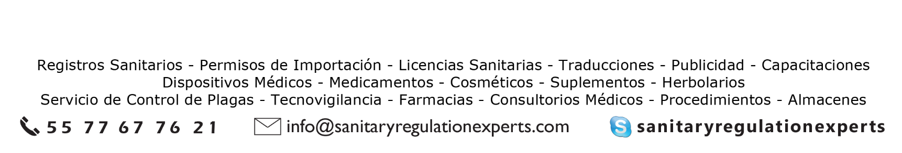


www.sanitaryregulationexperts.com
A partner and representative from
2020

Slide 14
MEDICAL DEVICES CLASIFICATION IN MEXICO
Source: Suplemento de Dispositivos Médicos de la Farmacopea de los Estados Unidos Mexicanos

Slide 15
CLASIFICATION: RISK LEVEL
Class III
Known
Variation in its materials or concentration
Introduced in the body – 30 days
Class II
Known
Safety and proven effectiveness
Not introduced in the body
Class I
Excempt of Health Regulation
New
Recently accepted
Introduced in the body +30 days
Class IA
Used in medical practice but does not meet the definition of Medical Device (auxiliaries)
Safety and proven effectiveness
N/A: sterile presentation, diagnosis, life support
Use does not result in physical injuries

Slide 16
CLASIFICATION: FUNCTION / INDICATION OF USE
Medical Equipment
Prosthesis, Orthosis and Functional Aids
Diagnostic Agents (IVDs)
Odonatological Supplies
Surgical and Healing Material
Hygienic Products

Slide 17
FAMILY GROUPING FOR MEDICAL DEVICES
Fuente: Suplemento de Dispositivos Médicos de la Farmacopea de los Estados Unidos Mexicanos

Slide 18
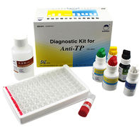
DIAGNOSTIC AGENTS (IVDs)
1. REAGENT KIT OR PACKAGE
Group:
Reagents
Controls
Calibrators
Buffers
Solutions
Criteria:
Same determination / identification
For the same analyte or parameter
Same analysis method (clinical chemistry, colorimetric, spectrophotometry, etc)

Slide 19
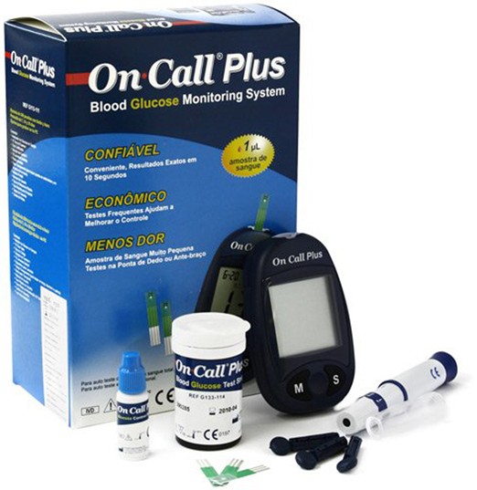
DIAGNOSTIC AGENTS (IVDs)
2. GLUCOMETERS AND OTHER DIAGNOSTIC EQUIPMENT
Group:
Test strips
Control
Calibrator
Criteria:
Only if all of them are used in the same equipment
Cannot group:
Lancets (Medical Instruments)
Glucometer or self diagnostic equipment (Medical Equipment)
If you want to assemble the kit, first each component must have its separate authorization and then apply for a new application asking for grouping them in a kit

Slide 20

DIAGNOSTIC AGENTS (IVDs)
3. CULTURE MEDIUM
Group:
All the nutritional material in which you can:
Recover
Multiply
Isolate
Apply susceptibility test
Criteria:
Same composition or formula
Same physical appearence

Slide 21
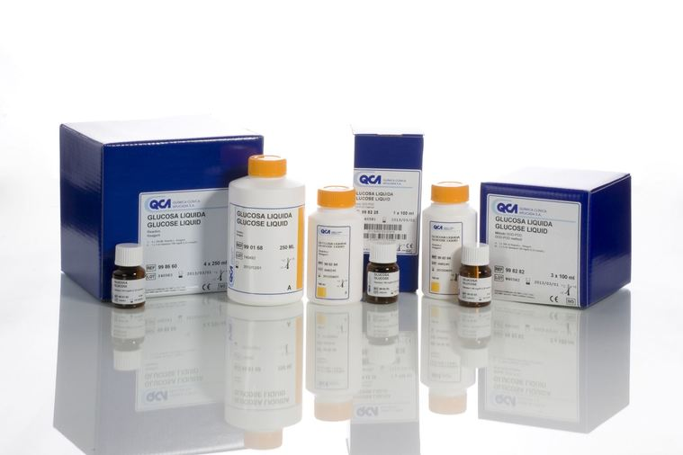
DIAGNOSTIC AGENTS (IVDs)
4. CONTROL MATERIAL ( CHECKERS )
Group:
Preparations that evaluate:
Accuracy
Precision
Criteria:
Same speciality

Slide 22
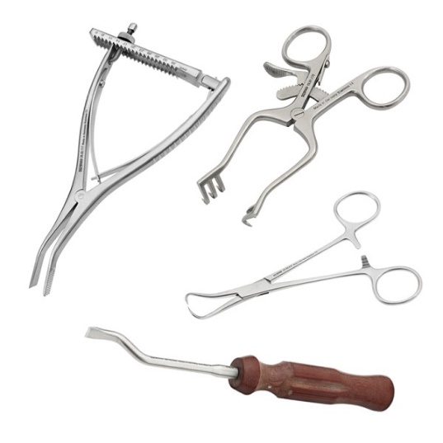
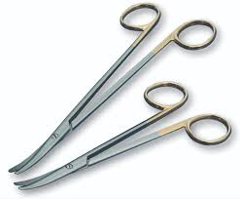
MEDICAL INSTRUMENTS
Group:
Variety of types or models of medical instruments
Criteria:
Same type of instruments, including their different presentations or models, as long as they are of the same material and have the same indication of use
Different instruments used in the same indication of use / technique or specific surgical procedure
or

Slide 23
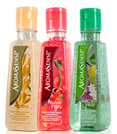
HIGIENIC PRODUCTS
Group:
Variety of presentations
Criteria:
Same formula (the weight or amount of content may differ)
Dyes, flavorings or prefumes may differ, as long as their general physicochemical characteristics are preserve

Slide 24
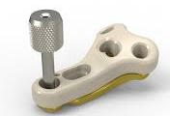
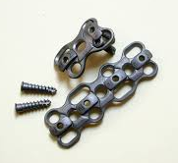
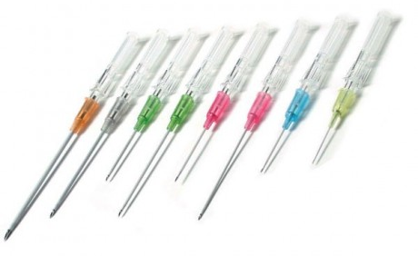
PROSTHESIS, ORTHOSIS AND FUNCTIONAL AIDS
Group:
Same type of product with its different presentations or models
Criteria:
Same material
Same formula or compsition
Same indication of use
If you want to assemble the kit or system with several kind of components, they must be for the same indication of use
Instuments are registered separately

Slide 25
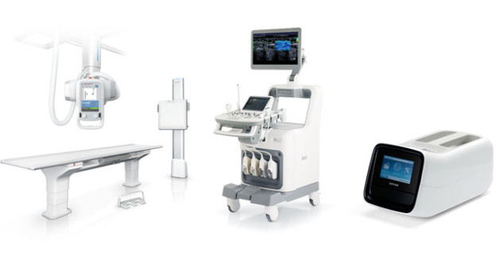
MEDICAL EQUIPMENT
Group:
Medical equipment+ accesories
Group:
Different models of medical equipment
Criteria:
They are part of the same medical equipment
Criteria:
Same technology
Same indication of use

Slide 26
GENERAL CRITERIA
Same manufacturer or its subsidiaries or authorized external manufacturer
The product, from the generic point of view, should have the same comercial or distintive denomination with the same indication of use
Keep the sale distintive name in case of products for distribution in different comercial chains

